Slide 1

BITS BRIGADE
Group No. :
Intel® Unnati Industrial Training Program 2024.

Slide 2
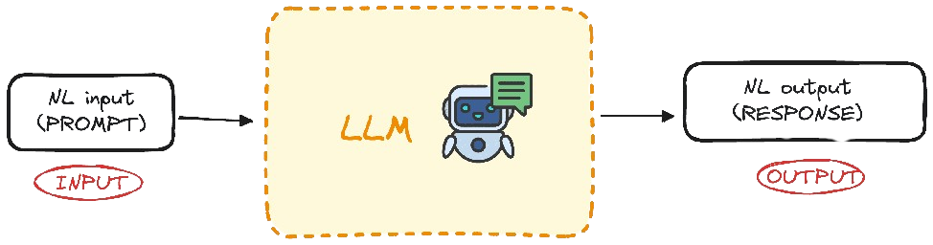
Problem Statement :
Introduction to GenAI and Simple LLM Inference on CPU and fine tuning of LLM Model to create a Custom Chatbot

Slide 3
Unique Idea Brief (Solution) :
Our project focuses on the innovative utilization of a pre-trained Language Learning Model (LLM) to develop a bespoke chatbot.
By implementing straightforward LLM inference on a CPU and fine-tuning the model, we aim to create a highly adaptable chatbot capable of addressing a variety of needs.
This approach leverages advanced AI techniques to enhance interaction capabilities, including text generation, summarization, and voice communication, thereby providing a comprehensive solution for modern communication challenges.

Slide 4
Features Offered :
Text Chat Training: Our chatbot is meticulously trained to handle text-based interactions, ensuring fluid and coherent conversations.
Voice Chat Training: Equipped with voice processing capabilities, the chatbot can seamlessly manage and respond to voice inputs, offering a more interactive user experience.
Mixed Precision (BF16) Optimization: The incorporation of mixed precision optimization accelerates model training and inference, significantly boosting performance without compromising accuracy.

Slide 5
Plugins for Text-to-Speech (TTS) and Automatic Speech Recognition (ASR): These plugins enhance the chatbot’s functionality, enabling it to convert text to speech and recognize spoken language, thereby broadening its application scope.
Custom Fine-Tuning: The model is fine-tuned for specialized tasks such as code generation, summarization, and text generation, ensuring it meets specific user requirements with high efficiency.
Integrated Tools and Libraries: Utilizing a robust suite of tools and libraries, including Intel Extension for Transformers, pytorch, peft, tensorflow, and accelerate, we optimize performance and streamline the development process.

Slide 6
Process Flow :
1. Importing Required Libraries :
2. Configuring BF16 Optimization
3. Enabling Plugins for Text-to-Speech (TTS) and Automatic Speech Recognition (ASR)
4. Reapplying BF16 Optimization for a Different Query
5. Finetuning of Custom dataset

Slide 7
Process Flow :
Importing Required Libraries: Prepare the environment by importing the necessary modules.
Configuring BF16 Optimization: Set up mixed precision optimization for improved performance.
Enabling Plugins for Text-to-Speech (TTS) and Automatic Speech Recognition (ASR) : Set up plugins for additional functionalities like TTS and ASR.
Reapplying BF16 Optimization for a Different Query : Optionally configure and make predictions with different queries or configurations.
Finetuning of custom dataset: Finetuning of alpaca_cleaned_dataset for meta-llama/Llama-2-7b-chat-hf model.

Slide 8
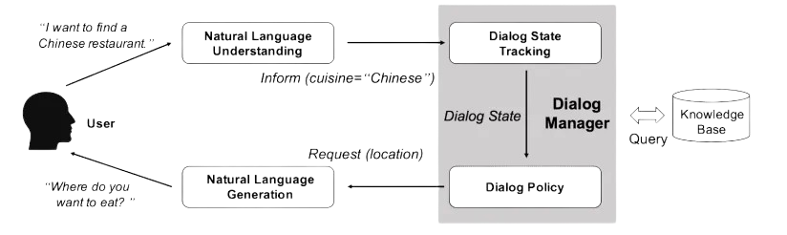
Architecture Diagram :

Slide 9
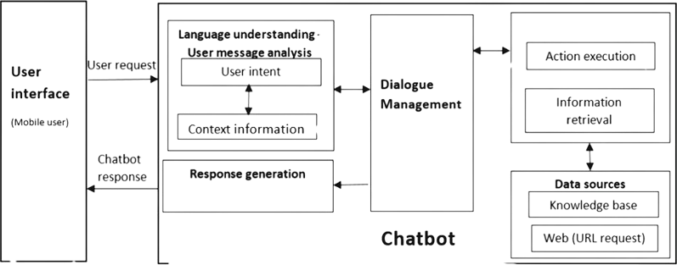
Architecture Diagram :

Slide 10
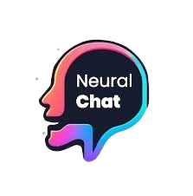



Technologies Used :
Intel Extension for Transformers (IET): (NeuralChat)
Purpose: Optimizes transformer models for Intel hardware.
Mixed Precision (BF16):
Speed up model training and inference without significantly affecting accuracy.
Chatbot Framework: ( build_chatbot, PipelineConfig )
Purpose: Builds and runs the chatbot model.
Plugins: ( Text-to-Speech(TTS), Automatic Speech Recognition (ASR) )
Purpose: Extends the chatbot functionality to include speech features.
Tools:
Intel Developer Cloud, Huggin Face, GitHub
Libraries :
Pytorch , accelerate , transformers 4.35.2 , huggingface_hub , tensorflow 2.13.0 , etc.

Slide 11
Team Members and Contribution:
Atharva Date (Lead)
Voice Chat Training for building chatbot,
Fine tuning model for Code Generation
Anshu Vairagade
Text Chat Training for building chatbot,
Fine tuning model on Summarization task
Yash Ukirde
Low Precision Optimization for building chatbot,
Fine tuning model for Text Generation task

Slide 12
Conclusion :
In summary, our project exemplifies the strategic application of a pre-trained LLM, optimized for CPU-based inference and meticulously fine-tuned for distinct tasks. The integration of advanced features like mixed precision optimization and speech processing plugins positions our chatbot as a versatile and high-performance solution. This initiative not only showcases the potential of custom fine-tuning in enhancing language models but also underscores its applicability across diverse domains, thus providing a significant advancement in AI-driven communication technologies.

